Slide 1

Online College Requirement System
Presented By:
1. PRIYADHARSHINI.A (510419104054),CSE,AEC
2.JASEEMABEGUM G (510419104036), CSE, AEC
3.SANTHANALAKSHMI.S(510419104059),CSE,AEC
Supervisor:
Mrs.V.UMADEVI
DEPARTMENT OF
CSE
ASSISTANT PROFESSOR, CSE,
ARUNAI ENGINEERING COLLEGE.

Slide 2

ABSTRACT
The Online recruitment system allows the job seekers to view the job
opportunity through Advertisement and helps to apply for the job.
The organization shortlist the applicants for the interview. The
shortlisted applicants undergo through a process of Test and Interview.
The HR department selects the Applicant based on the performance in
the Test and Interview. Finally the recruited applicants are informed.
This system makes the task of the job seeker easier rather than waiting
in queue for enrollment. This also reduces the time consumption for
both for the job seeker and Organization

Slide 3
EXISTING SYSTEM
We consider a company that we can automate its recruitment process and this company
is currently using a manual system to recruit employees; since recruiting employees
manually is a time consuming, possibly erroneous in employing in competent
individuals, thus wasting of the company’s money or loosely speaking not a wise
strategy in terms of economy.

Slide 4
PROPOSED SYSTEM
ØThe System provides an online interface to the user where they can fill in their
personal details and apply for the job.
ØThe Organization (HR-Department) concerned with the recruitment process can make
use of this system to reduce their workload and process the application in a speedy
manner.
Ø Provide a communication platform between the Applicant and the Organization.

Slide 5
ADVANTAGE
• It makes the requirement process easier for the organization
• Easy to access the system anywhere and anytime.

Slide 6
SYSTEM SPECIFICATION
Software Requirements :
Operating system : Windows 7
User interface
Platform
: ASP. Net
: Microsoft visual studio 2010
: SQL server 2008
Database
Server deployment: IIS(Internet Information server)6.0
Framework
: .Net Framework 4.0

Slide 7

SYSTEM SPECIFICATION
Hardware Requirements :
Processor
: INTEL PENTIUM IV
Operating system : Windows 7
RAM
: 3GB
Harddisk
Keyboard
Mouse
: 250GB
: 104 KEYS
:LOGITECH
Monitor
:”14”SVGA Color Monitor

Slide 8
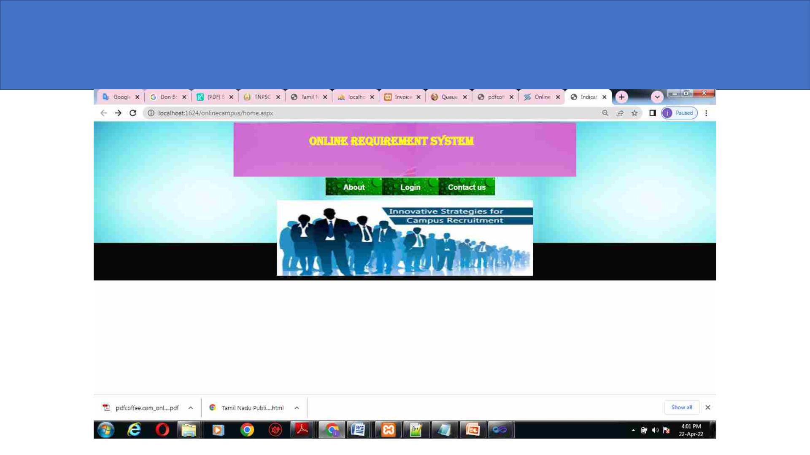
MODEL WEB PAGE

Slide 9
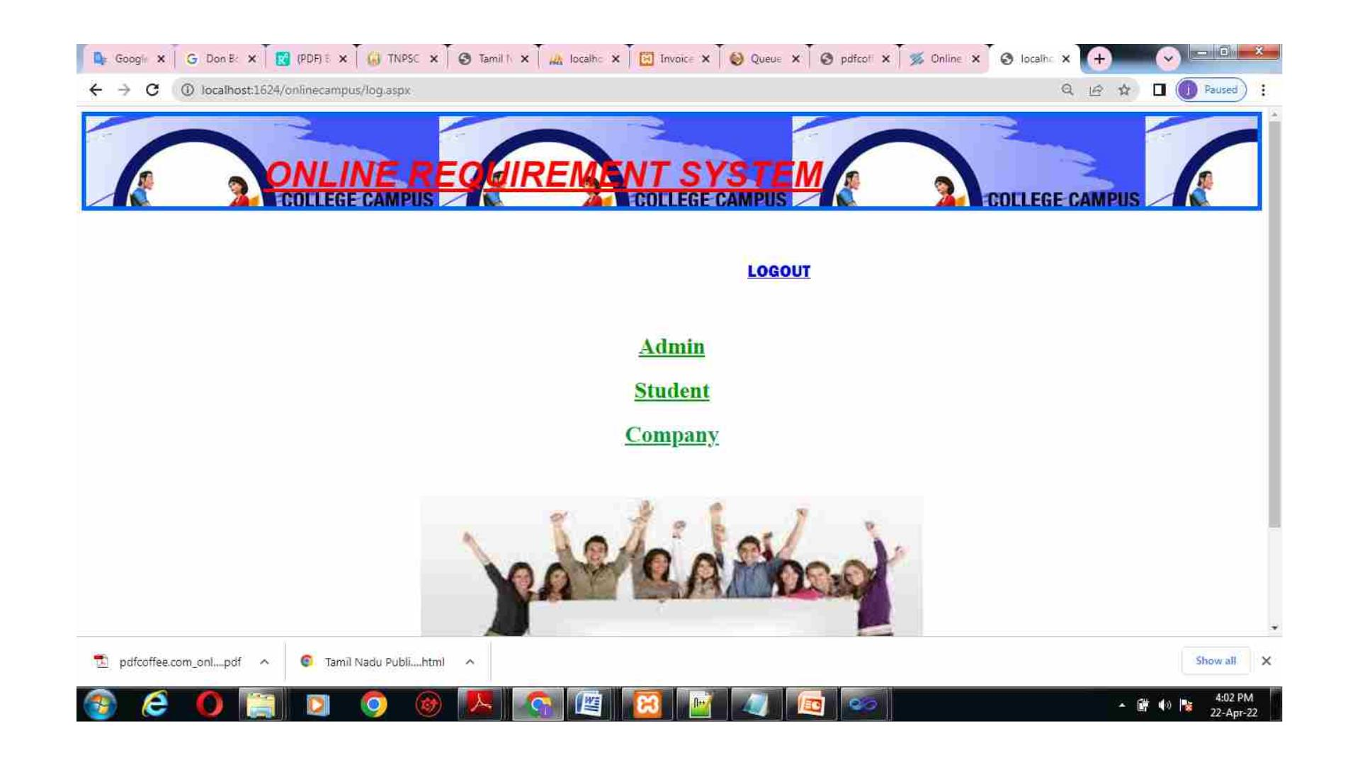

Slide 10
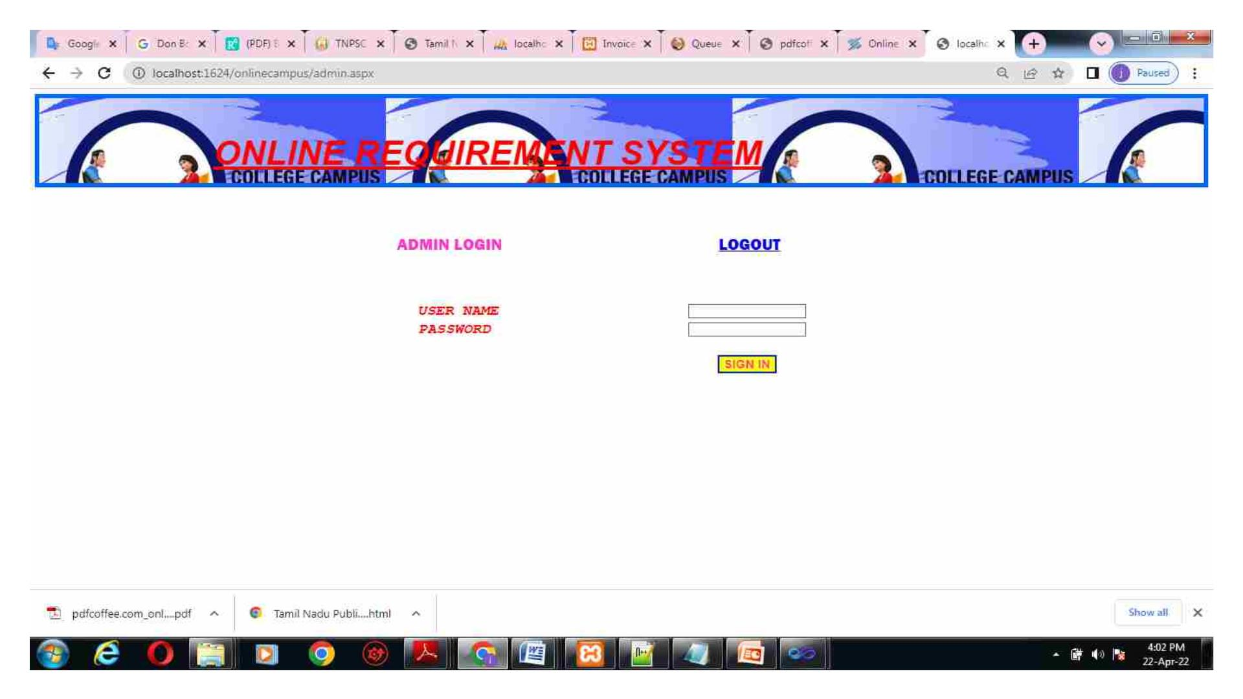

Slide 11
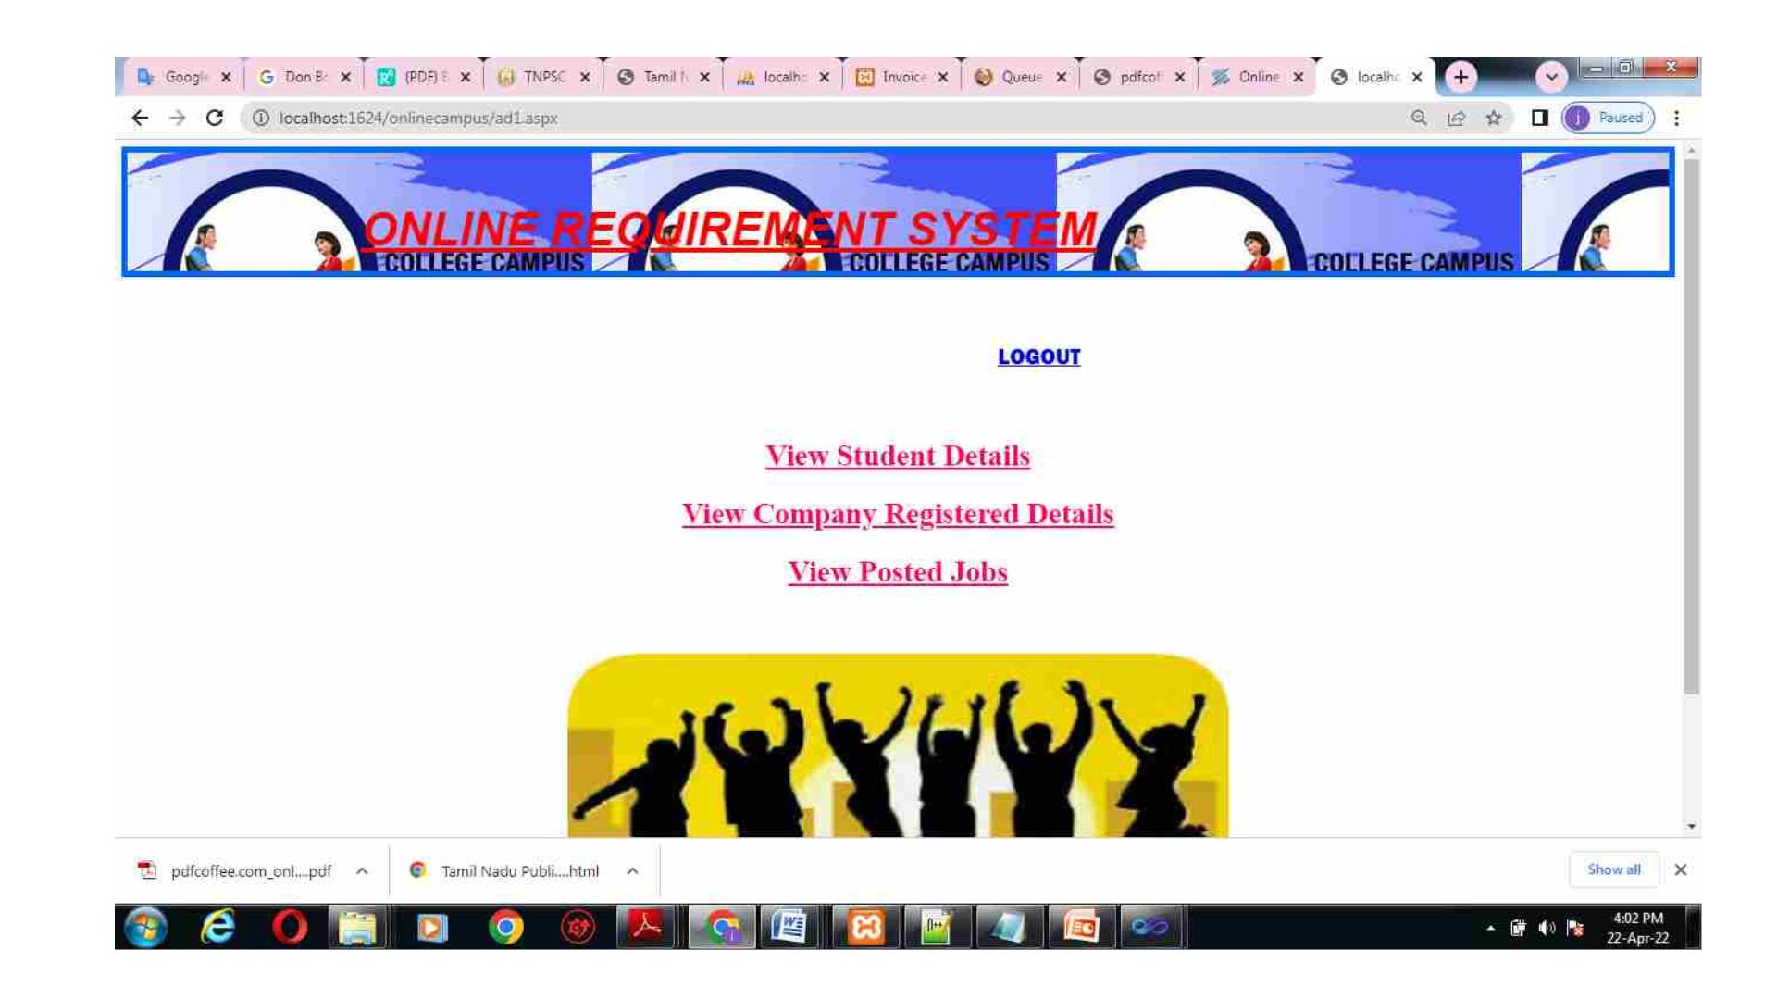

Slide 12
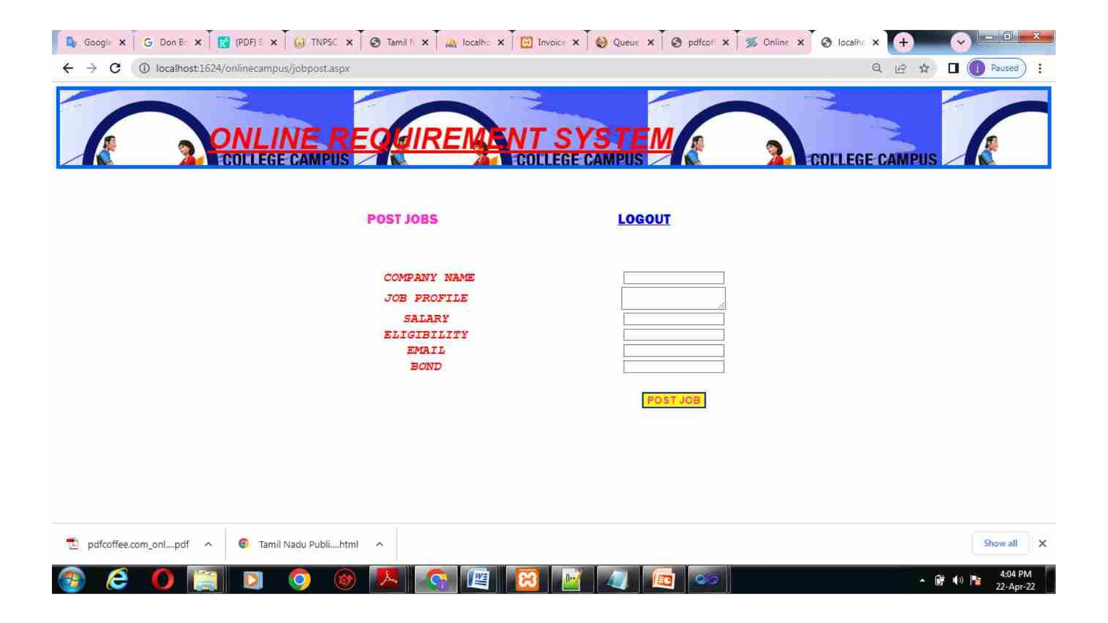

Slide 13

MODULES
• User:
• Applicant is an actor who applies for the job vacancy. If he/she gets
selected then HR department sends the Interview call letter.
• Company:
• HR is an actor who informs about the vacancy to their Organization.
HR recruits the applicants based on the required skill for the vacant
position and shortlist them. HR is also responsible for Interview
Scheduling. Organization is an actor who announces the
Advertisement for vacancy.

Slide 14

ADMIN
• This module provides delete the user and company information.

Slide 15
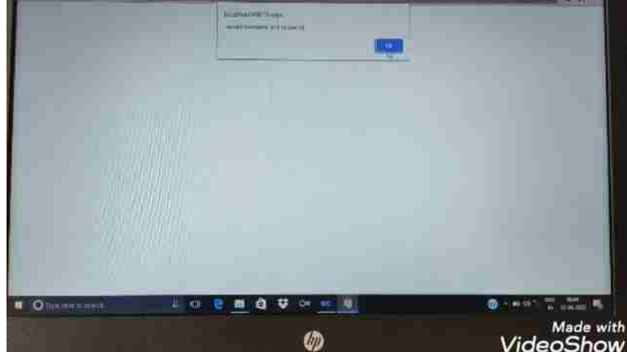

Slide 16

THANK YOU
DEPARTMENT OF
CSE

